Slide 1

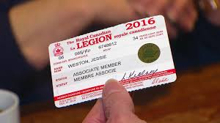



Remember - Join - Give
Service Officer
Training
25 November 2017

Slide 2
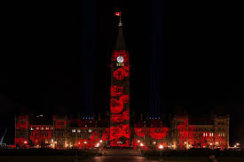
Agenda
Opening ritual
Introduction – Agenda - Command S/O, Branch S/O
S/O Handbook – Website www.legion.ca
Role of Command S/O
Role of Branch S/O
Terms of reference and Guide to Service Work
Legion Service bureau network
DVA - District Office
DVA Programs Listing
Disability Benefits + application
Programs available through the Legion
Special Legion section OSI + New drug regulation (Marijuana)
Legion Claim application
Poppy Fund Request
Benevolent Fund
Funerals & Burials
VIP
Long Term Care
Finding Veterans on PEI
Community & Youth
Contact Information
Questions

Slide 3

Provincial Service Officer
Meaghan Rockman
1st Thursday of each month –
G.R Pearkes VC Branch
no.5 Summerside
At Command office Monday, Wednesday and Thursday from 9:00am to 2:00pm
Phone: 902-892-2161
Fax: 902-368-8853
e-mail royalcanadianlegion@pei.aibn.com

Slide 4
Role of Command Service Officer
Role of Command Service Officer
Resource for the Branch Service Officer and Poppy Chair related to service work upon referral from branches;
Authority for disability claim preparation and submission:
- First application, Departmental review, VRAB’s, and co-representation with the
Bureau of Pension Advocates;
- Poppy Fund assistance, Benevolent Fund Applications, Housing Referrals, and
Senior Housing Requirements.
Our role is to serve veterans new and old, and their dependents, to promote Remembrance and to act in the service of Canada and it’s communities.
A client does not need to be a Legion member to receive support as any Canadians Forces Veterans can obtain support from the Legion.

Slide 5
How we can help….
Legion Branch Service Officers are the eyes and ears of the Service Bureau Network at the grass roots level, who often first come into contact with Veterans and their families. Branch Service Officers assist Veterans by identifying those with unmet health needs and possible benefits from VAC and then by making appropriate referrals to Command Service Officers.

Slide 6
Role of Branch Service Officer
Role of Branch Service Officer
As defined in General Bylaws, Service Officer Handbook and Branch Manual, the Branch Officer investigates Poppy Fund Applications and approves grants for:
- Food, clothing, shelter and the necessity of life;
- Works with the Branch Poppy Chair.
Referral agent to the Command Service Officer for disability claims.
However, the Branch Service Officer may assist applicants with paper work and claim application forms that have been registered by VAC.
Legion Claim Application Form (2013) must be signed and dated by the applicant before representation can be affected.
For security reasons and the safeguard of personal related information the Branch Service Officer does not have access to DVA personal data.

Slide 7

Terms of references – Branch Service Officer
Reference material:
General Bylaws
Service Officer Handbook
Branch Manual
Branch Bylaws
Poppy Manual and;
RCL website at: www.legion.ca

Slide 8

The Legion Service Bureau
The Legion Service Bureau Puts Client Confidentiality First When Representing Veterans
The Royal Canadian Legion provides free, professional counselling and representation services for still-serving Canadian Armed Forces members, Veterans, RCMP members and their families regarding disability claims or related issues with Veterans Affairs Canada (VAC) and the Veterans Review and Appeal Board (VRAB). Professional Command Service Officers are mandated by legislation to provide representation at all levels of the disability claim process under the Pension Act or the Canadian Forces Members and Veterans Re-establishment and Compensation Act.
In order to do this important work on behalf of Veterans and their families, the Legion requires access to confidential client information. VAC has a Memorandum of Understanding (MOU) with the Legion to maintain client confidentiality and ensure appropriate use of client information.
Access to client information is controlled and monitored by VAC and is in accordance with the Access to Information Act and Privacy Act. As defined in the MOU, VAC will grant the Legion Command Service Officers access to Veterans Affair’s client information only on signed consent from the client authorizing access. At any time, the client may limit or cancel the Legion’s access to their file by advising any VAC office.
The privacy and confidentiality of Veterans and their families are of utmost importance to the Legion. Our Command Service Officers are security cleared through VAC and adhere to the same safeguards and level of care as is provided by VAC departmental personnel.
In any given year, the Legion helps an average of 3,200 Veterans with their disability claims. If you or a Veteran you know needs help, please contact the Legion Service Bureau. All services are free of charge, and you do not need to be a Legion member to access our services.
We are here to help! Call 1-877-534-4666 or email servicebureau@legion.ca

Slide 9

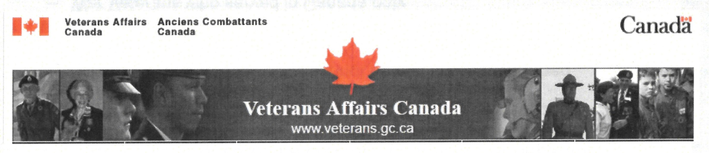
DVA District Office
Location:
Jean Canfield Building
1st Floor
191 Great George Street
Charlottetown, PEI
C1A 4L2
Telephone: 1-866-522-2122
Hours: Monday to Friday, 8:30 to 4:30, local time
What they do?
Services provided…….

Slide 10

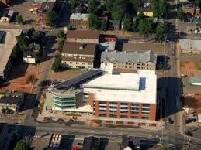
Programs offered through DVA
Disability Benefits
Mental Health
Financial support
Transition to Civilian life
Health and well-being
Veterans, CAF, RCMP, and Families
Homeless
Reviews and Appeals
contact: www.veterans.gc.ca/services
information@vac-acc.gc.ca

Slide 11
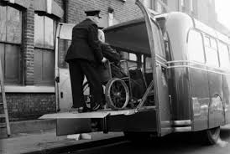
Disability Benefits
Disability Benefits
Disability benefits are financial payments provided to individuals who have a service-related disability.
To receive a disability benefit you must:
have a diagnosed medical condition or disability; and
be able to show that the condition or disability is related to your service.
There are two types of disability benefits
Disability Pension
Disability Award
The amount of a Disability Pension depends on:
- the degree to which that disability is related
to your service (entitlement); and
- the extent of the disability (assessment).
Your rank or years of military service have no impact on the amount you may receive.
Additional pension amounts may also be awarded for qualified dependents (e.g. spouse, common-law partner and/or children).
You may also qualify for additional allowances if you receive a Disability Pension.

Slide 12
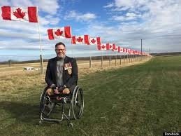
Disability Applications
First Application
- is the very first application made by the veteran for any and all disability applications.
Must establish cause and effect and link to the military;
Departmental Review
- is the second review for an unfavorable First Application. Can only be submitted if there is new
evidence or proof of an error in law;
Veterans Review and Appeal Board Hearing
- Is the third level of appeal or review for an unfavorable decision of the second level
(Departmental Review);
- Applicant is able to attend Appeal Hearing and give evidence in front of a panel of two
adjudicators. Bureau of Pension advocates (lawyer) Representative and Legion Co-
Representation. (District Office)
Veterans Review and Appeal Board
- Bureau of Pension Advocate Lawyer or Dominion Command Legion
Representative. Teleconference Hearing;
Supreme Court of Canada
- Applicant obtains legal representation at own expense

Slide 13
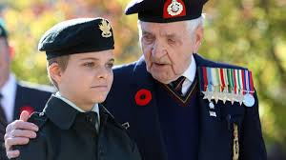
Programs offered through the Legion
Assistance with VAC
Financial assistance
Mental Health and PTSD
Homeless veterans
Outreach and Visitation Initiative
VIP
Support for families
Support for Seniors
Funerals and Burials
Poppy Fund Assistance
Further explanation on some of theses programs

Slide 14

Financial assistance….
The Royal Canadian Legion provides financial assistance to serving and former Canadian Armed Forces members, RCMP, and their families who are in financial distress. Grants are available for food, heating, clothing, prescription medication, medical appliances and equipment, essential home repairs and emergency shelter or assistance. Smaller comforts can also be provided to Veterans and surviving spouses who are hospitalized.
Any Veteran or Veteran’s dependent in need of assistance is eligible to apply for financial aid from the Poppy Trust Fund, including:
Any person who is serving or who has honorably served in the Canadian Armed Forces or the RCMP, as well as their dependents
Merchant Navy personnel who have been awarded campaign stars or decorations, as well as their dependents
Ex-service personnel of Commonwealth countries and their dependents who reside in Canada

Slide 15


Mental Health and Post-Traumatic Stress Disorder (PTSD)
Mental illness is one of the most widespread health issues in Canada, and The Royal Canadian Legion is committed to ensuring Veterans and their families have access to the help and support they need.
Immediate, emergency help is available:
For an emergency or crisis situation, call 911.
Call the crisis help line at 1-800-268-7708.
This is a 24-hour toll-free crisis help line offering short-term professional counselling and referral services.

Slide 16


Medicinal Marijuana
Legalization and Regulation of Cannabis
as recommended by the Task Force, the cannabis for medical purposes regime will continue to exist to provide access to individuals who have the authorization of their healthcare practitioner to use cannabis for medical purposes. The Task Force also recommended that the Government monitor and evaluate patients' reasonable access to cannabis for medical purposes during the implementation of the new law, and then evaluate the medical access framework within five years of implementation of the law, which the Government intends to do.
Will be officially legalized in Canada in July 2018
Info at www.Canada.ca

Slide 17
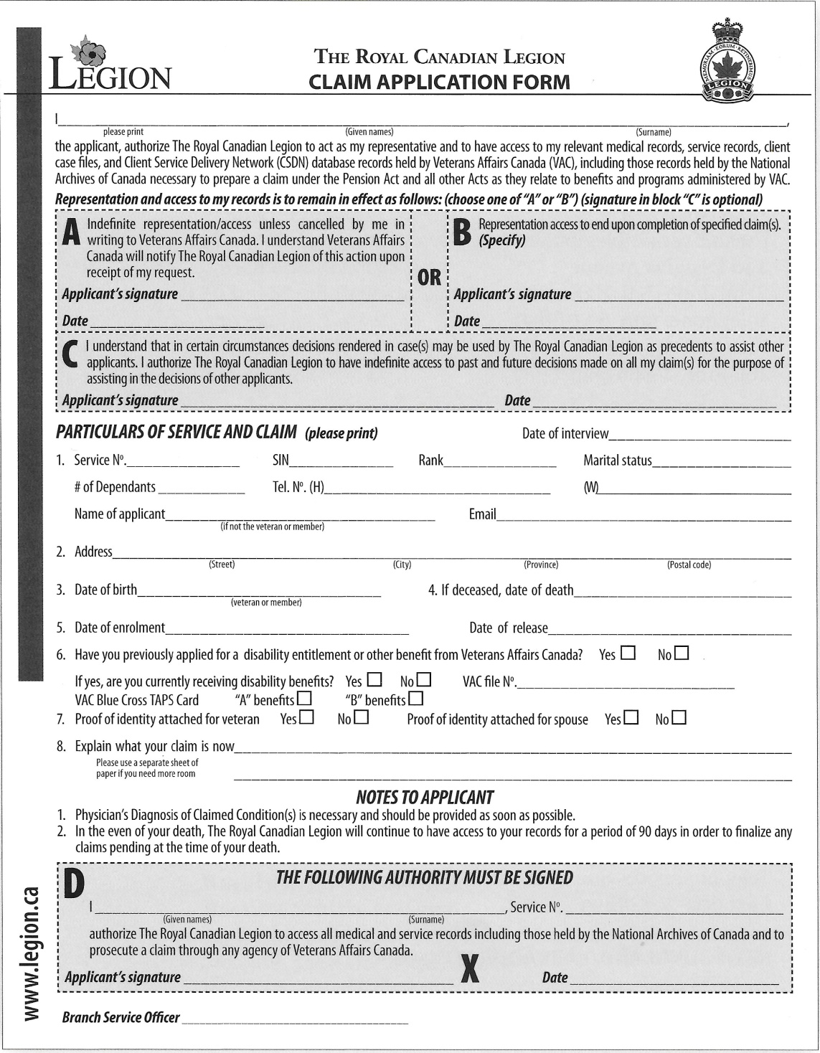




Slide 18
Filling out the Claim Form
Filling out the claim form
- Block printing;
- Two signatures required;
- Date each signature;
- Requires service information.
Particulars
- Ensure that all service dates are included;
- Regular force or reserve force choice;
- Enrollment date – release date;
- #8 as brief as possible;
- Ensure that Service Number is in Section 1 & D on the form;
-Mail in the original with two pueces of ID centered on one page.

Slide 19
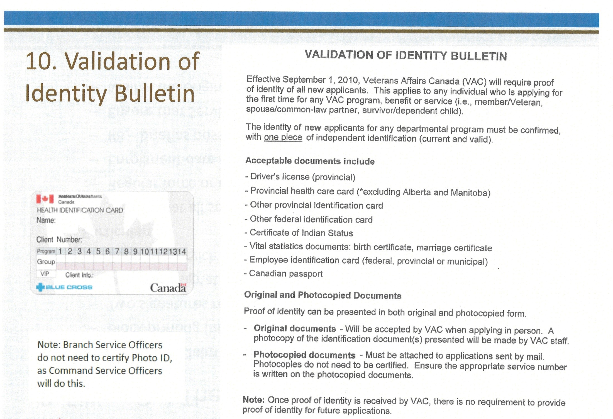

Slide 20
Identification Page
Two pieces of ID centered on one page;
First one must be photo ID:
- Drivers license, passport, service ID, etc
Second ID can be:
PEI Medical card, PEI ID card, or anything proving
who the applicant is.
If Power of Attorney is making application for applicant:
copy of the notarized POA and ID must accompany
Legion Claim Form.

Slide 21
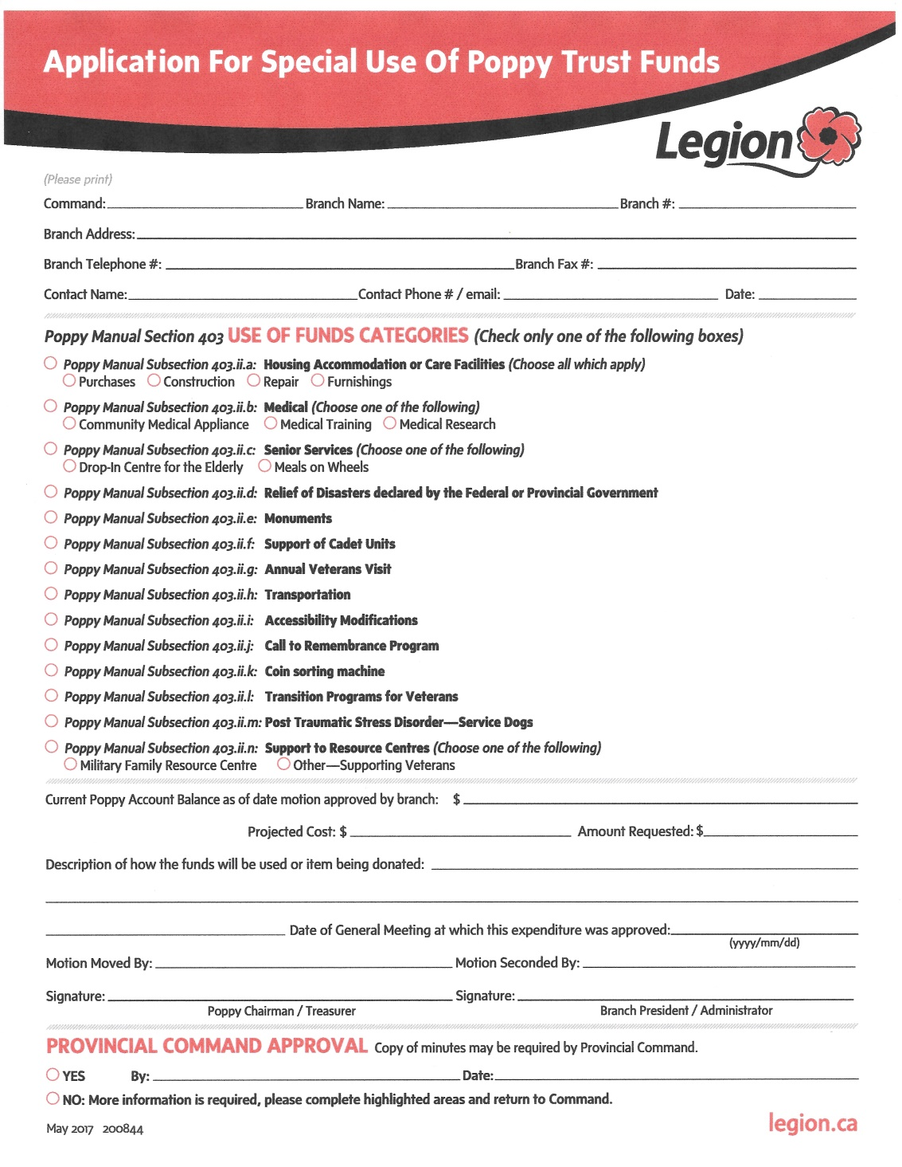


Poppy Fund Request for Assistance

Slide 22

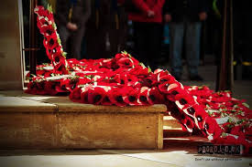
Benevolent Fund
Providing Basic Emergency Assistance
There are a number of Benevolent Funds which provide assistance to veterans, ex-service personnel and their dependents.
Applications for Benevolent Fund assistance are made through a Veterans Affairs counsellor or your Provincial Service Officer.
The purpose of these funds is to provide emergency assistance, which is not otherwise available. Requests for assistance usually relate to the basic needs of food, shelter and medical care and the assistance is designed to be on a one time basis.
Need to fill in “VAC 1278” application

Slide 23
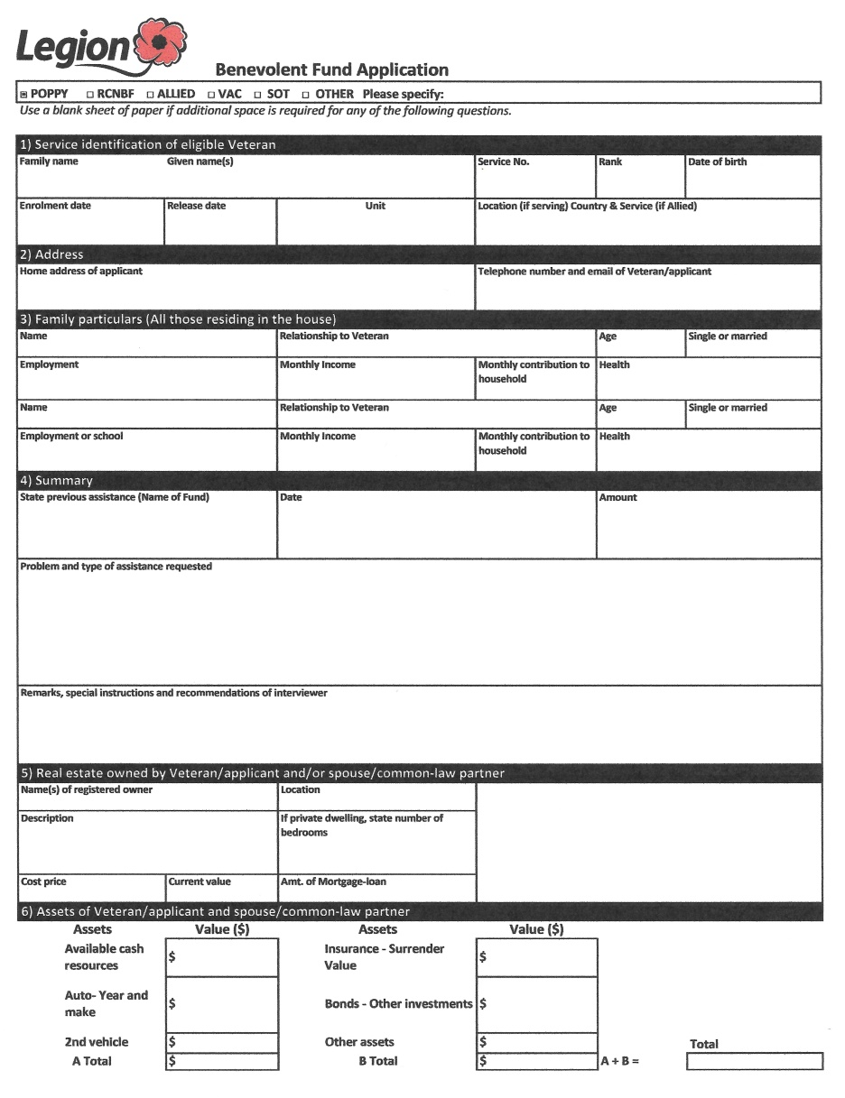
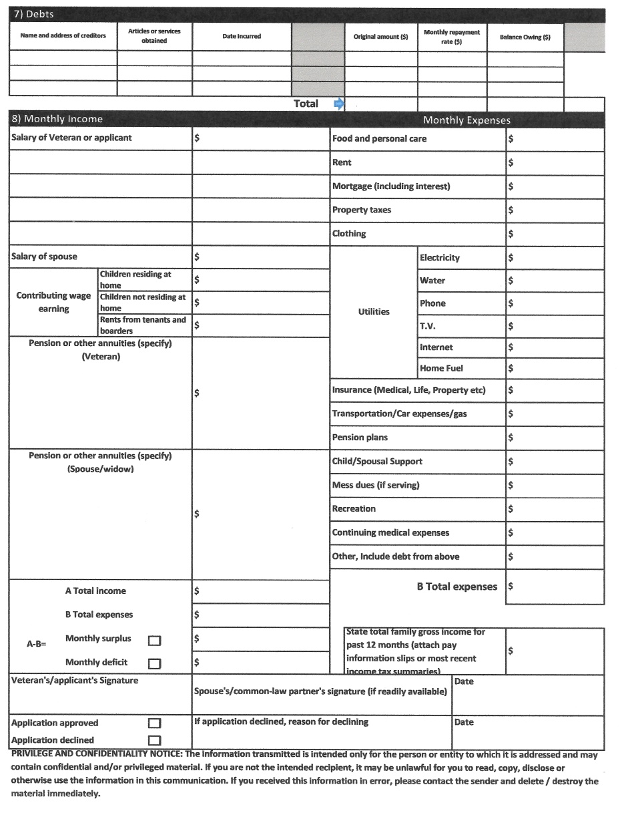
Benevolent Fund Application

Slide 24

Leave the Street Behind
How we can help
Trained Legion Command Service Officers can assist with the following:
Finding suitable accommodation: Legion Provincial Commands work closely with Veterans Affairs Canada, shelters and community organizations to get Veterans off the street and into temporary and/or long term accommodations.
Financial assistance: Through the Poppy Fund, housing support is provided through financial assistance for items such as first and last month’s rent, rental arrears and furnishings.

Slide 25
Legion Sponsored Accommodations
Miscouche #18 – Legion Senior Citizen Home (9)
Montague #8 – Legion Senior Citizens Home (12)
O’Leary #2 – O’Leary Legion Dev. Corp (16)
North Rustico – Sunrise Lodge (6) as the Branch closed it doors the community took over its administration

Slide 26
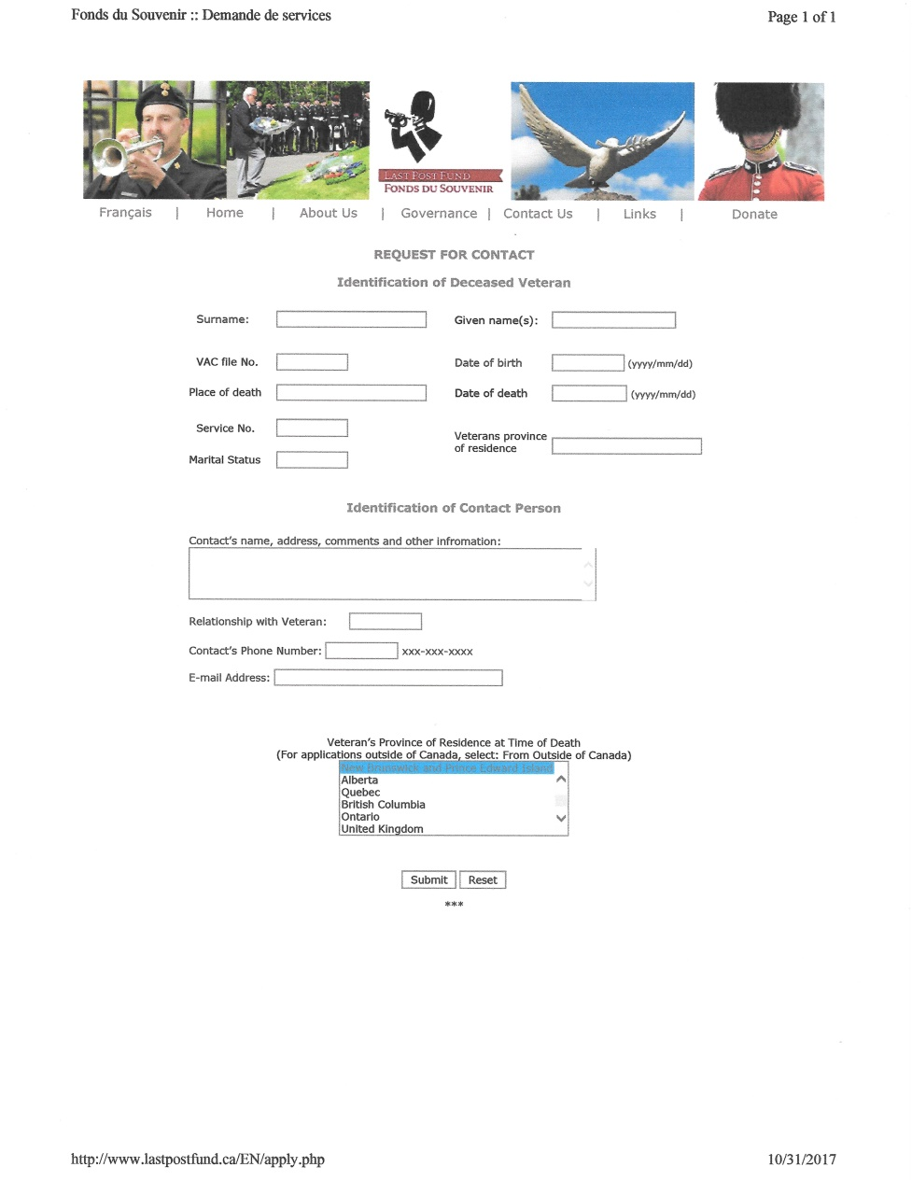

Funerals and Burials Assitance
The Veterans Affairs Canada Funeral and Burial Program ensures that eligible Veterans receive dignified funeral and burial services.
The Last Post Fund (LPF), a non-profit organization, delivers the program on behalf of Veterans Affairs Canada. To be eligible for the program, Veterans must meet both military and financial criteria.

Slide 27



Veterans Independence Program
The Veterans Independence Program (VIP) helps you remain independent and self-sufficient in your home and your community. Depending on your circumstances and health needs you may qualify for financial assistance to obtain services such as grounds maintenance; housekeeping; personal care; access to nutrition; health and support services provided by a health professional.

Slide 28
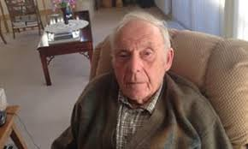


Outreach & Visitation Initiative
Veterans Affairs Canada (VAC) supports approximately 6,800 Veterans in almost 1,400 long-term care facilities.
The Royal Canadian Legion delivers the Outreach and Visitation Initiative (OVI) on behalf of Veterans Affairs Canada.
Through this partnership, the Legion facilitates face-to-face visits with these Veterans, providing them with an opportunity to have a social visit with a Legion volunteer and to raise concerns or identify needs that might be addressed by Veterans Affairs Canada.
Contact: Gary Foster – Project Coordinator
Toll-free: 1-877-534-4666
E-mail gfoster@legion.ca
You can become a volunteer for OVI……
Training is provided.

Slide 29
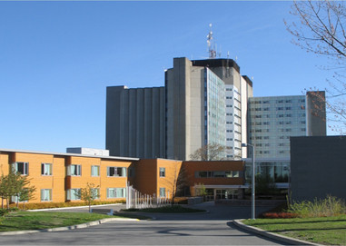
Long Term Care Settings
LONG TERM CARE SETTING
Veterans may receive financial support for long term care in:
- Contract beds in facilities where VAC has agreements with the province,
health authority and/or facility for priority access to a designated number of beds
- Community beds in facilities operated by health authorities, private
and not-for-profit sectors that provide care to provincial residents
- Departmental beds at Ste. Anne’s Hospital

Slide 30
Program Eligibility
Program Eligibility
VAC contributes to the cost of care if specific criteria are met, including the type and location of military service, income, and whether the need for care is linked to a service–related disability.
Veterans eligible for care in a contract, community or departmental bed include:
-War Veterans who served overseas, are income qualified, or are receiving a
disability pension
- Allied Veterans whose needs cannot be met in community beds
Veterans eligible for care in a community bed only include:
- War Veterans who served in Canada only
- Allied Veterans
- Canadian Forces Veterans who need care because of a disability from an injury or
illness related to military service

Slide 31
How does it work?
How does it work?
The delivery of long term care is a provincial/territorial responsibility
The assessment and placement process to access most long term care facilities is managed by provincial / regional / local health authorities
If a veteran needs long term care, VAC can contribute to the cost of care if the veteran meets certain criteria (e.g. military service, income eligibility, etc)
If a facility is full, a Veteran may be placed on a waitlist or given other placement options
With home care services and support available from the Veterans Independence Program, many Veterans remain independent at home

Slide 32
Current Situation
Current Situation
9,423 Veteran clients are in long term care in Canada
- 2,697 Veterans in contract beds
- 6,322 Veterans in community beds
- 404 Veterans in Ste. Anne’s Hospital
Veterans are in contact beds in 159 facilities and in community beds in approximately 1,750 facilities across the country.
Most Veterans prefer to access community beds in facilities close to family, friends and other social support.

Slide 33




Community & Youth
Legion Riders
National Memorial Ride
The National Memorial Ride (NMR) is an annual commemorative event that brings together motorcycle enthusiasts and supporters to remember and commemorate Canada’s Fallen Veterans at the National Military Cemetery at Beechwood Cemetery. Held annually in June.
Legion partnership with Ride For Dad
The Legion is a proud partner of Ride For Dad, a non-profit organization that combines the love of motorcycles with a commitment to supporting prostate cancer research and raising public awareness of the disease.
Track & Field
The Legions’ National Youth Track &
Field competition is the only one of its
kind in Canada and has come to be
regarded as one of the best in the country. Annually, it helps hundreds of athletes aged 12 to 17 years to develop their potential and strive to become Canada’s future Olympians.
Many Canadians don’t realize that the Legion is one of the largest supporters of community youth activities in the country.
The Legion promotes Remembrance to the younger generation and works with schools and youth organizations to keep the memories of our Fallen Veterans alive.
The Legion also supports youth leadership programs and activities such as Cadets, Scouts and Guides, and youth sports, helping build the next generation of leaders.
Youth scholarship and bursary programs, coordinated at the Branch level.
Through The Royal Canadian Legion's longstanding Annual Poster and Literary Contests, Canadian school children honour Canada’s Veterans through creative art and writing, and help perpetuate Remembrance.

Slide 34
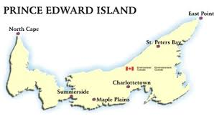


Finding Veterans on PEI
The Legion does not know where and who they are…..
DVA knows of those who have pension or benefits – about 2,500 on their database….
It is estimated the number to be about 6,000
on the Island…….
The Veterans with mental illness are harder to find as they tend to live by themselves.
In the last couple of years new Armed Forces recruits are added to DVA database as they join the military.
How to find them?

Slide 35
Contact Information
Meighan Rockman – Command S/O
Command Office (902) 892-2161
e-mail: royalcanadianlegion@pei.aibn.com
Web: www.peilegion.com
DVA/VAC -
134 Kent St, Charlottetown, PE C1A 1N2
Ph: (902) 566-8677 Charlottetown Office
Web: www.veterans.gc.ca
e-mail: generalenquiries@dva.gov.au.
Dominion Command – RCL
Main reception: 1- 613-591-3335
Toll-free: 1-888-556-6222
Web: www.legion.ca
Service Bureau/Veteran Support: 877-534-4666
RCL Partnership:
OSISS
Vets Canada
RCMP Pension
Wounded Warriors
MFRC
Soldier ON

Slide 36
Thank You for Participating
Questions……………?

